Slide 1
Software Fault Detection Using Machine Learning
Presented by: Harsh Raj
219302137
Under the Guidance of Dr Debolina Ghosh

Slide 2
Index
Research Objective
Literature Review
Methodology
Dataset Collection
Dataset Measurement
Machine Learning Models/Algorithms
Results
Conclusion

Slide 3
Research Objective
1
Software Quality Improvement: By predicting faults, developers can implement preventive measures such as code review, improving documentation, or enhancing test coverage, ultimately leading to higher software quality.
2
Risk Mitigation: Identifying potential fault-prone areas helps in prioritizing testing efforts and allocating resources where they are most needed, reducing the risk of software failures in production.
3
Early Flaw Detection in Software: Utilize early-level software metrics to improve design and reduce faults in software systems.
4
Testing Cost Reduction: Employ fault prediction to optimize test effort allocation, achieving significant cost savings without compromising fault-finding efficiency.

Slide 4
Literature Review
Author (year) | Objective of the study | Methodology/approaches/ tools/techniques used | Advantages | Research Gap
Iqra Mehmood; Sidra Shahid; Hameed Hussain; Inayat Khan; Shafiq Ahmad; Shahid Rahman (2023) | - To improve Software Defect Prediction Accuracy | Two-tail t-testing SVM Random Forrest Logistic Regression Baye’s Net WEKA tool used | Early Identification: Predicts flaws in source code before testing, enabling early defect identification. Dataset-Centric Approach: Recognizes the dependency on dataset characteristics for choosing appropriate prediction methods. Feature Selection: Utilizes feature selection, improving the accuracy of specific algorithms like Bayesian Net. | Future Work is Broad and Generic: specific goals or hypotheses could enhance its focus. Complexity of Software Systems Not Explored: Although the study mentions the increasing complexity of software systems, it does not delve into how this complexity may impact the accuracy and effectiveness of defect prediction models.
Sushant Kumar Pandey, Ravi Bhushan Mishra, Anil Kumar Tripathi (2021) | - Survey of Machine learning based methods for Software Fault Detection | SVM Logistic Regression Baye’s Net ANN Decision Tree | Research Queries and Protocols: The formulation of research queries and the development of a review protocol based on previous articles demonstrate a methodical and evidence-based approach to gathering information. Score-Based Evaluation: The use of scores in Tables A.14 to A.16, along with corresponding categories in Table A.9, provides a quantitative assessment of the relevance of articles to SFP over ML. | Generalization of Results: While the study indicates an average AUC range and accuracy for ML- based SFP models, it does not explicitly discuss the generalizability of these results to diverse datasets or project types. Dataset Availability: The call for freely available datasets by industries is mentioned, indicating a limitation in the availability of datasets for SFP research.
Lei Qiao, Xuesong Li, Qasim Umer, Ping Guo (2019) | -Deep Learning Based Software Defect Prediction. | SVM FSVR DTR | Versatility: The proposed approach aims to predict the number of defects in software modules, showcasing its applicability across different projects and datasets. Change-Level Predictions: The plan to investigate defect predictions at the change level . | Overfitting Risk: It's essential to ensure that the model generalizes well to new and unseen data, especially when applied to different projects and programming languages. Data Availability Hurdles: The reliance on new and commercial datasets may encounter challenges due to access restriction.

Slide 5
Literature Review
Author (year) | Objective of the study | Methodology/approaches/ tools/techniques used | Advantages | Research Gap
Xing Xing, Jianyan Luo, Zhichun Jia, Yanyan Li, and Qiuyang Han(2019) | -Fault Detection for Web Services | - Naïve Bayes | Automation: The framework automates the fault detection process, reducing the need for manual intervention. This can save time and resources in identifying and addressing service faults. Utilization of Service Execution Logs: Leveraging service execution logs for creating the training set is advantageous as it allows the model to learn from real-world data, capturing patterns and nuances specific to the actual service operation. Naïve Bayes Classification: The Naïve Bayes approach is known for its simplicity and efficiency in classification tasks. It is particularly effective when dealing with a large number of features, making it suitable for processing service execution logs. | Naïve Bayes Assumption: The Naïve Bayes approach relies on the assumption of independence among features. In real-world scenarios, this assumption may not always hold, potentially leading to suboptimal performance in certain cases. Threshold Sensitivity: The effectiveness of the model is contingent on an appropriately chosen threshold value. Setting this value too low may result in false positives, while setting it too high could lead to false negatives. Determining an optimal threshold may require additional tuning and experimentation. Limited to Log Data: Depending solely on service execution logs might limit the model's ability to detect faults caused by issues outside the scope of logged events. It may miss faults that manifest in ways not captured by the available log data.
Thi Minh Phuong Ha, Duy Hung Tran, LE Thi My Hanh, Nguyen Thanh Binh (2019) | -To improve Software Defect Prediction Accuracy (experimental study) | Logistic Regression SVM Decision Tree MLP KNN Naïve Bayes Random Forrest | Focused Use of Object-Oriented Metrics: The study leverages object-oriented metrics, providing a specific and relevant set of indicators for evaluating and improving software quality. Performance Comparison: Results highlight that Support Vector Machine excels in predicting faults at the class-level, while Multilayer Perceptron stands out for method-level datasets. This provides valuable insights for practitioners in selecting appropriate techniques for different aspects of software development. | Limited Exploration of Classification Techniques: The mention of future work involving the study of classification techniques to address dataset imbalance implies that this aspect has not been fully explored in the current research. This could limit the depth of understanding regarding dataset challenges. Metrics and Techniques Selection: The study doesn't elaborate on the rationale behind the choice of specific object-oriented metrics or why these seven machine-learning techniques were selected. Providing this context could enhance the credibility and transferability of the findings.

Slide 6
Methodology
1
Project Definition and Scope: Develop a machine learning model to detect and predict software faults, enhancing overall software reliability.
5
Model Training: Train the selected models on the training dataset.
2
Data Collection and Preprocessing: Collect diverse datasets, including both spam and non-spam.
6
Model Evaluation: Evaluate models using metrics such as accuracy, precision, recall, and F1-score
3
Data Analysis (DA): Perform statistical analysis on the dataset. Visualize the distribution of data.
7
Testing and Documentation: Conduct thorough testing to identify and fix any issues.
Document the entire process, including data sources, methodology, and model details
4
Model Selection: Choose appropriate machine learning models for classification (e.g., Naïve Bayes, Support Vector Machines, K Nearest).

Slide 7
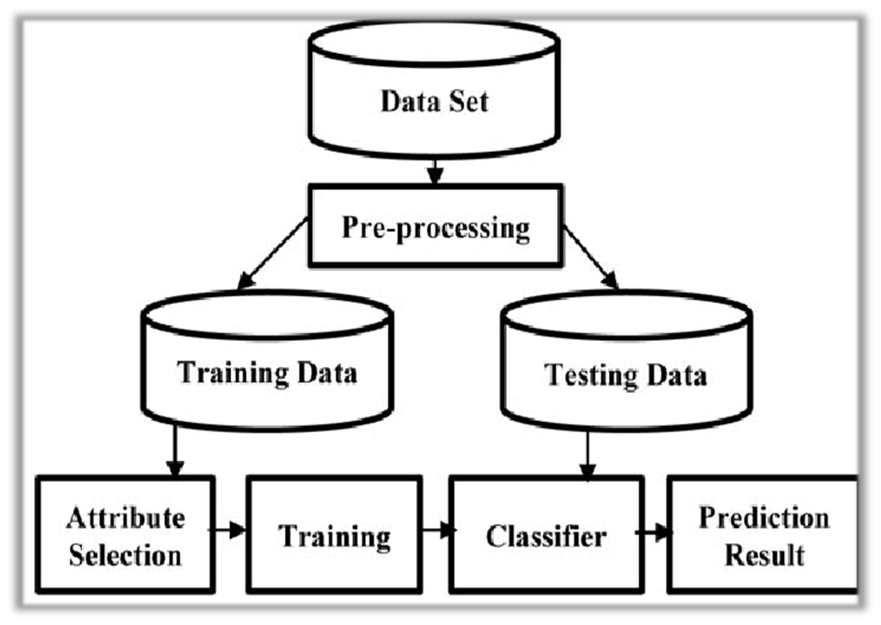
Methodology
Fig: Methodology for Software Detection

Slide 8
Dataset Collection
Data is collected from the NASA Metrics Data Program (MDP) for various purposes related to software engineering research:
1
Empirical Studies: The MDP offers datasets collected from diverse NASA projects, providing researchers with empirical data to study software development processes, project characteristics, and software quality.
3
Process Improvement: By analyzing MDP datasets, researchers can identify areas for process improvement in software development practices, helping to enhance productivity, quality, and reliability in mission-critical domains such as aerospace engineering.
2
Defect Prediction: Researchers use MDP datasets
to build models for predicting software defects, leveraging the included metrics and defect data to identify patterns and factors contributing to software faults.
Data is collected from the NASA MDP to conduct empirical studies, develop defect prediction models, and drive process improvement efforts in software engineering, particularly within the context of NASA's projects and missions.

Slide 9
Dataset Collection
The experiment utilized three freely accessible datasets from the PROMISE Software Engineering Database. It categorized metrics into Halstead and McCabe metrics, along with miscellaneous ones. McCabe metrics assess code complexity and structure, including line of code and cyclomatic complexity. Halstead metrics provide insights into program complexity and size, such as operators and operands. Other metrics like input/output code and comments contribute to advanced program feature analysis. Defect presence or absence was recorded as a binary metric. These metrics are crucial for software quality assessment and defect prediction, aiding developers and researchers in improving software systems.
Table 1: Dataset details
S.No | Name | Total | True | False
1 | KC1 | 2109 | 326 | 1723
2 | CM1 | 498 | 49 | 449
3 | JM1 | 10885 | 8779 | 2106

Slide 10
Dataset Measurement
TP: True Positives (correctly predicted positive instances)
TN: True Negatives (correctly predicted negative instances)
FP: False Positives (incorrectly predicted positive instances)
FN: False Negatives (incorrectly predicted negative instances)

Slide 11
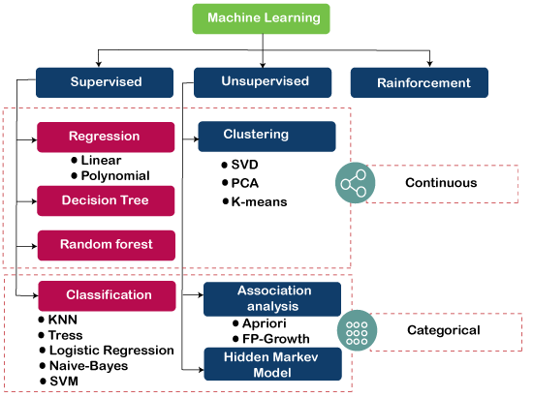
Machine Learning Algorithms

Slide 12
Results
The study focused on automated fault recovery in software, using a proactive approach. It involved several stages, including requirement analysis, design, testing, and data preprocessing. Five classifiers were applied to three fault datasets, with 80% used for training and 20% for testing. Results showed high accuracy, recall, F1 score, and precision across different datasets, indicating effective prediction of software defects.

Slide 13
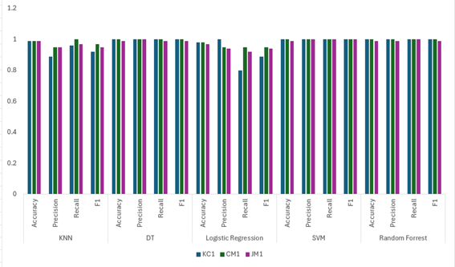
Results
Fig: Classification and performance of ml models

Slide 14
Conclusion
This research paper explores software fault prediction using machine learning techniques, emphasizing the importance of feature selection, data preprocessing, and model evaluation for accuracy.
The paper talks about using a computer program to predict mistakes in software development. I have tested this using data from NASA and found it worked well, with accuracy ranging from 89% to 100%. This implies its proficiency in identifying errors and enhancing program quality. In the future, I want to try more methods in the future to make it even better at predicting program crashes.

Slide 15
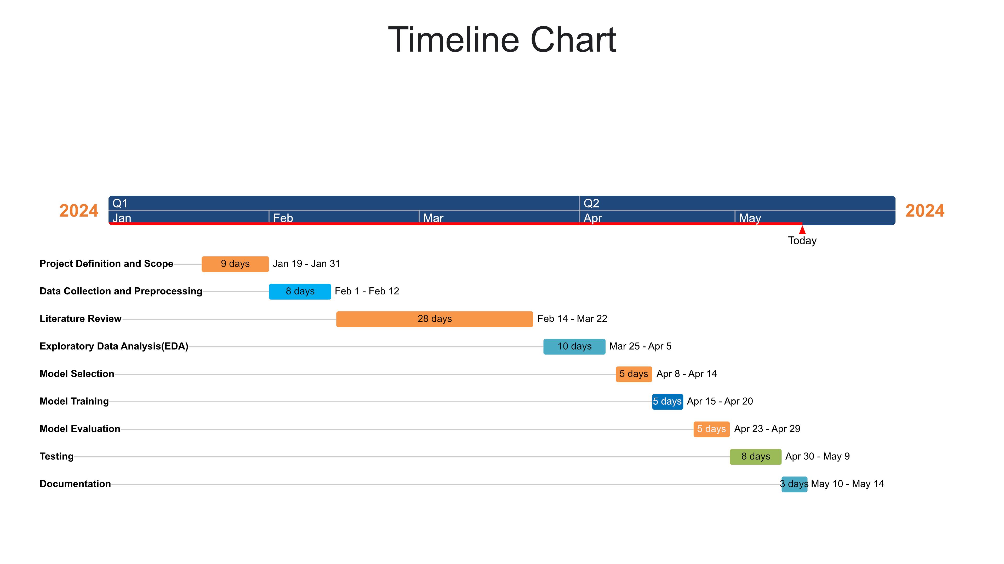

Slide 16
Publication under this work
"A Comparative Analysis for Software Fault Detection Using Machine Learning Techniques", 2nd International Conference on Data Science and Network Security (ICDSNS), ICDSNS-2024 (Communicated).

Slide 17
THANK YOU

